Slide 1

ME 361
MSc mechanical engineering
Industrial Machinery & Automation
Lecture 1
S. M. Sackey
sackeysm@yahoo.com // 0242 232 239

Slide 2
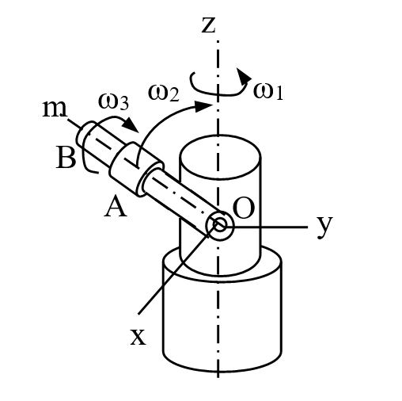
Linear, Angular Velocities, Transport Theorem
Example 1-1
Find the angular velocity and angular acceleration of sleeve A of Figure E1-1

Slide 3
Linear, Angular Velocities, Transport Theorem
Solution

Slide 4
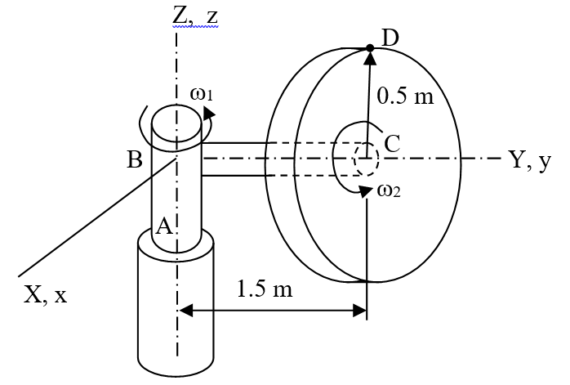
Linear, Angular Velocities, Transport Theorem
Example 1-2
The horizontal shaft BC in Figure E1-2 is rigidly attached to the vertical shaft AB. The vertical shaft AB rotates at a constant angular velocity ω₁ = 4 rad/s about the vertical axis while the disc mounted at the end of BC is rotates about the horizontal axis at ω₂ = 1 rad/s and α₂ =2 rad/s². Determine the angular velocity and acceleration of the disc.

Slide 5
Linear, Angular Velocities, Transport Theorem
Solution
The angular velocity of the sleeve is
Transport theorem
Using the transport theorem, the angular acceleration of the shaft is
of the arm OB is
Therefore the angular acceleration of the sleeve B which is being transported by both the shaft and the arm is

Slide 6
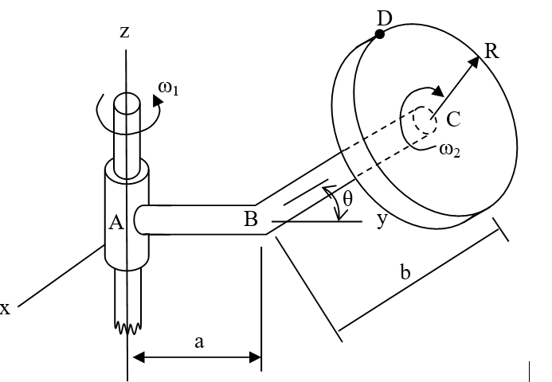
Linear, Angular Velocities, Transport Theorem
Example 1-3
In Figure E1-3, the bent pipe ABC is rigidly attached to a vertical shaft, which rotates with angular velocity ω₁ = 3 rad/s and angular acceleration α₁ = 1 rad/s² relative to the ground. The circular disc mounted at the point C rotates with constant angular velocity ω₂ = 5 rad/s relative to the bar. Knowing that θ = 30º, determine the
angular velocity of the disc relative to the ground
angular acceleration of the disc relative to the ground

Slide 7
Linear, Angular Velocities, Transport Theorem
Solution
Abs. angular velocity of the disc is
The angular acceleration of arm AB is
Similarly, the angular acceleration of the disc with respect to the fixed frame is

Slide 8
General Motion
Position and Displacement
r_{B} is the position of point A with reference to the origin of the fixed frame X, Y and Z
r_{A} is the position of point B with reference to the origin of the fixed frame X, Y and Z
r_{B/A} is the displacement of point B with reference to point A, the origin of the moving frame x, y and z

Slide 9
General Motion Equations
z
u
x
Z
Ω
y
X
Figure : A Moving Frame xyz Observed from a Fixed Frame XYZ
Y

Slide 10
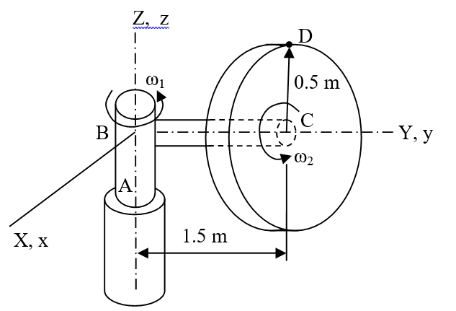
General Motion Examples
Example 1-4
Determine the velocity and acceleration of point D at the instant shown in Figure E1-4.

Slide 11
General Motion Equations
z
u
x
Z
Ω
y
X
Figure : A Moving Frame xyz Observed from a Fixed Frame XYZ
Y

Slide 12
General Motion Examples
Solution
From Example 1-2,
The velocity of point D becomes
The acceleration of point D is calculated as

Slide 13
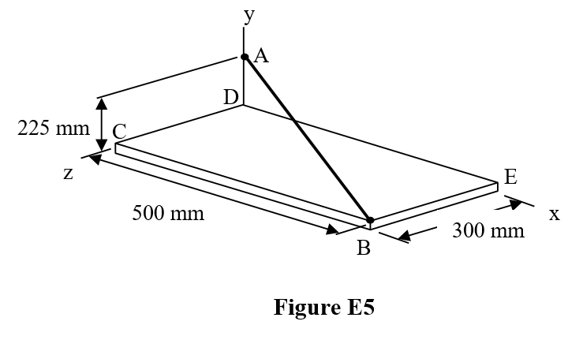
General Motion Examples
Example 1-5
The assembly shown in Figure E1-5 consists of two rods AB and AD, and a plate BCDE, which are welded together. If the assembly is rotating about AB with angular velocity is 15 rad/s anticlockwise, determine the velocity and acceleration of corner E.

Slide 14
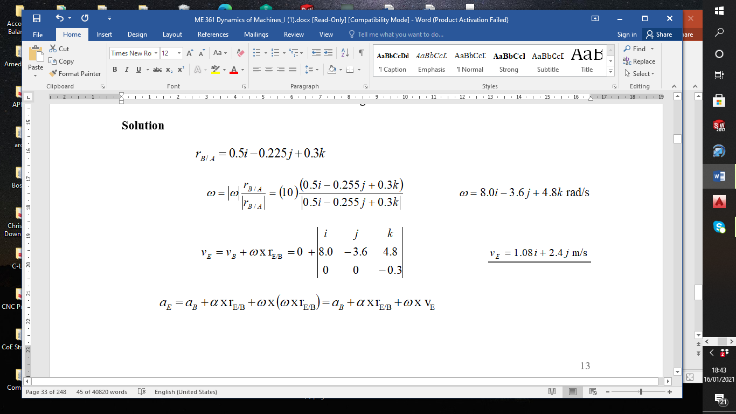
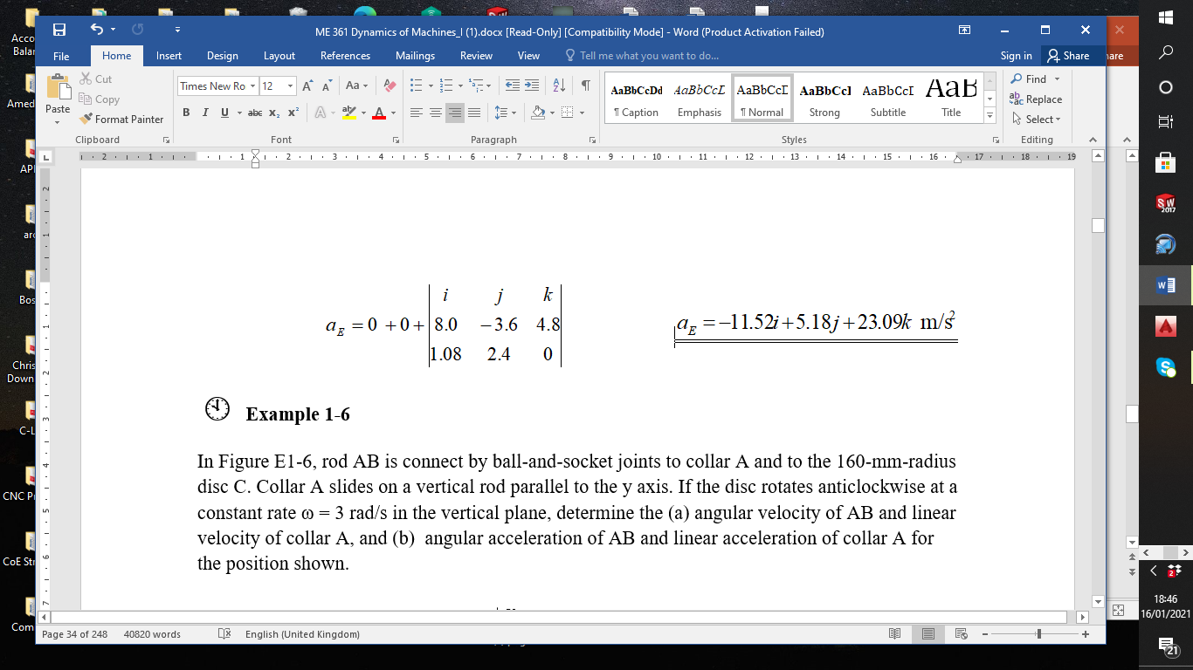
General Motion Examples

Slide 15
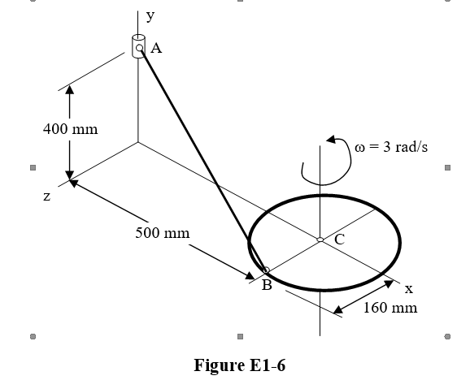
General Motion Examples
Example 1-6
In Figure E1-6, rod AB is connect by ball-and-socket joints to collar A and to the 160-mm-radius disc C. Collar A slides on a vertical rod parallel to the y axis. If the disc rotates anticlockwise at a constant rate ω = 3 rad/s in the vertical plane, determine the (a) angular velocity of AB and linear velocity of collar A, and (b) angular acceleration of AB and linear acceleration of collar A for the position shown.

Slide 16
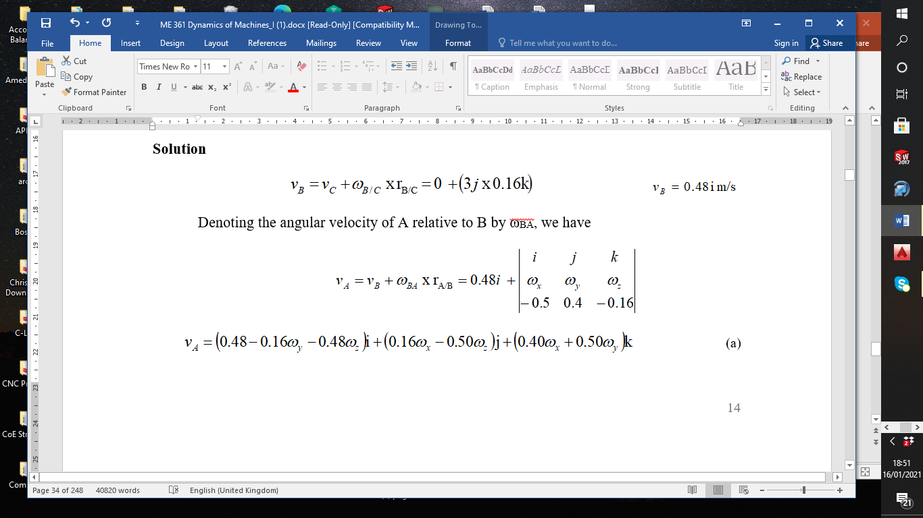
General Motion Examples

Slide 17
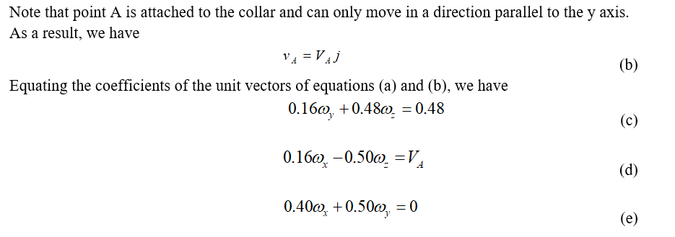
General Motion Examples
An additional equation is required, and is obtained by considering the constraint at point A. The connection at A allows rotation of BA about the vertical rod parallel to the y axis and about axis perpendicular to the plane containing the vertical rod and AB.

Slide 18
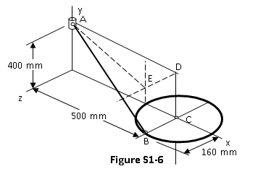
General Motion Examples
It prevents rotation of AB about the axis AE illustrated in Figure S1-6, which is perpendicular to vertical axis CD and lies in the plane of the vertical rod and AB. That is, the projection of angular velocity ω on r_{E/A} must be zero, which yields
(e)
(f)
Solving equations (c) to (f)
simultaneously, we have

Slide 19
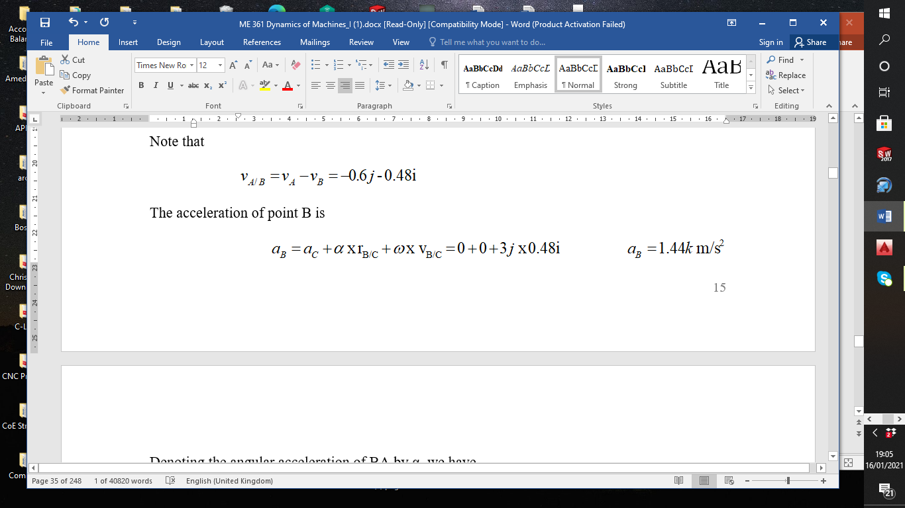
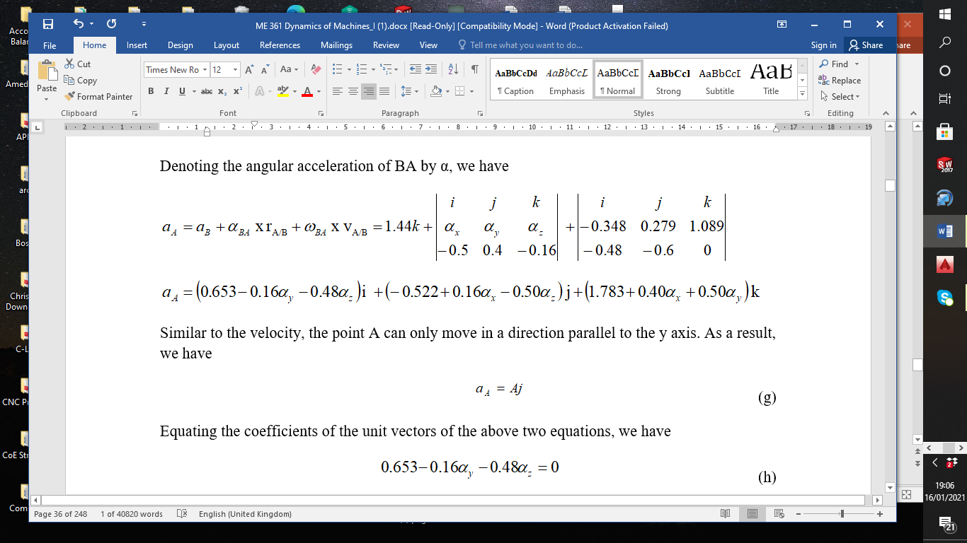
General Motion Examples

Slide 20
General Motion Examples

Slide 21
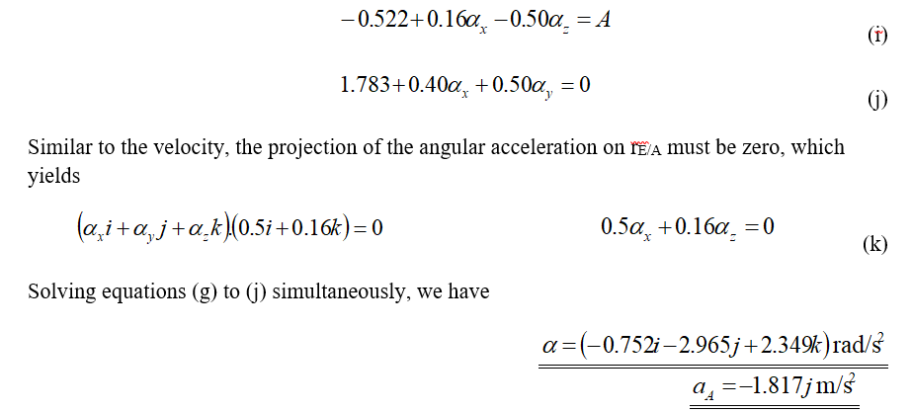
General Motion Examples

Slide 22
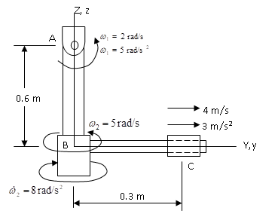
General Motion Examples
Example 1- 7
In Figure E1-7, the pendulum shown consists of two rods AB and BC. AB is pin supported at A, which allows AB to rotate only in the Y-Z plane. BC spins about the AB, and the sleeve at C slides on BC. Determine the velocity and acceleration of the sleeve at the instant shown.

Slide 23
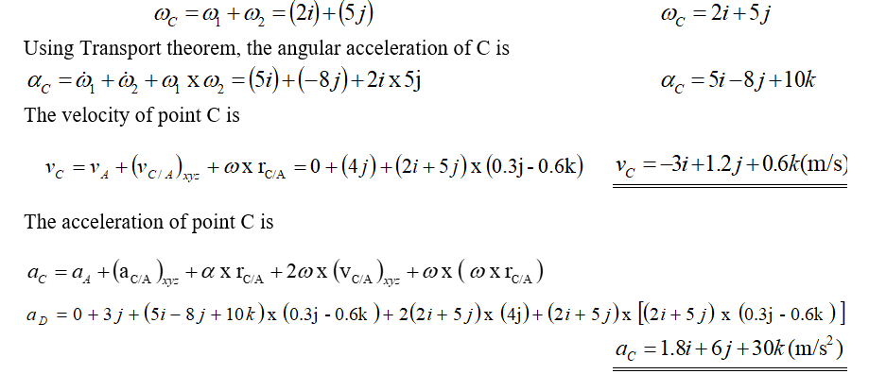
General Motion Examples
Solution
The angular velocity of C is

Slide 24
ME 361
MSc mechanical engineering
Industrial Machinery & Automation
Lecture 2

Slide 25
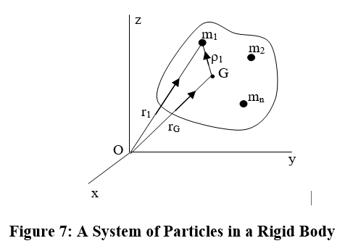
RIGID BODY GEOMETRY
Centre of Mass: Summation Method
The location of the centre of mass G is defined as
Equation 10
where
Equation 11
Note that r_{G} is a three-dimensional vector representing the x, y and z coordinates of the centre of mass. That is,

Slide 26
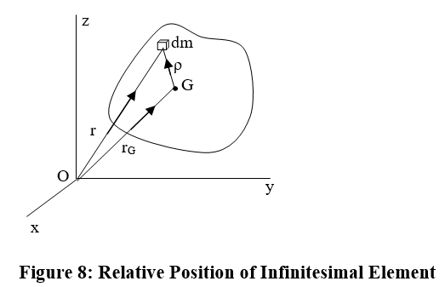
RIGID BODY GEOMETRY
Integration Method
Equations 10 and 11 are useful when the rigid body involved is constituted by discrete parts. As n→∞, each particle of the rigid body can be treated as a infinitesimal mass element as shown in Figure 8. Then, the location of centre of mass G may be defined as
where

Slide 27
RIGID BODY GEOMETRY

Slide 28
RIGID BODY GEOMETRY

Slide 29
RIGID BODY GEOMETRY

Slide 30

Thank You
For any concerns, please contact
elearning@knust.edu.gh
elearningknust@gmail.com
0322 191132

